Slide 1
Ageing error estimation
Pacific cod 2010-2019
Morgan Arrington

Slide 2
Methods
Quantified age reading error structure for readers with indices 3, 8, 21, 59, and 71
Tester with index 6 provided double reads on largest number of samples (n = 2128) out of 3147 total between the years of 2010-2019. Therefore, only used double read data where tester index 6 provided the test read to standardize approach.
Ageing error was estimated using the Punt et al. (2008) model
  Test reader index 6 was assumed to be unbiased in all cases
Simulated age data based on the probabilities from the estimated ageing error matrices

Slide 3
Reader index 3
Best supported model showed:
  Bias: with constant CV, i.e., a 1-parameter linear relationship of bias with true age
  Error: with curvilinear SD, i.e., a 3 parameter Hollings-form relationship of SD with true age

Slide 4
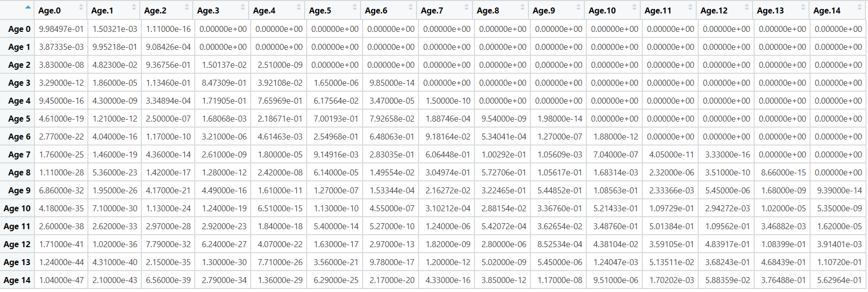
Reader index 3 – estimated ageing error matrix
Age estimate
True Age

Slide 5
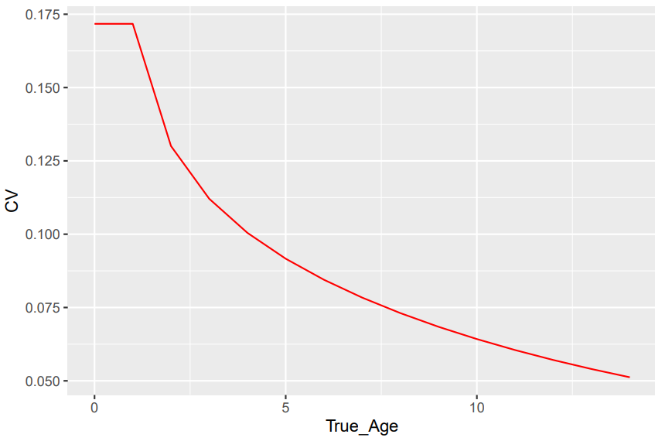
Reader index 3 – estimated CV

Slide 6
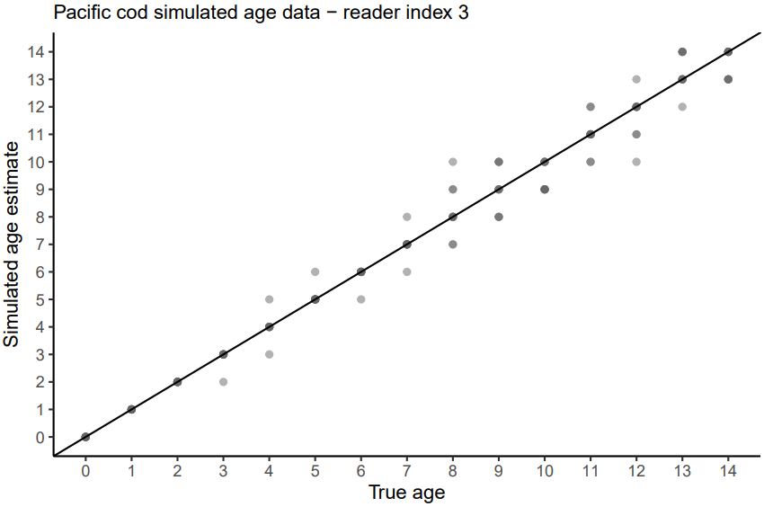
Reader index 3 – simulated data

Slide 7
Reader index 8
Best supported model showed bias
  Bias: Curvilinear, i.e., a 2-parameter Hollings-form relationship of bias with true age
  Error: Curvilinear SD, i.e., a 3 parameter Hollings-form relationship of SD with true age

Slide 8
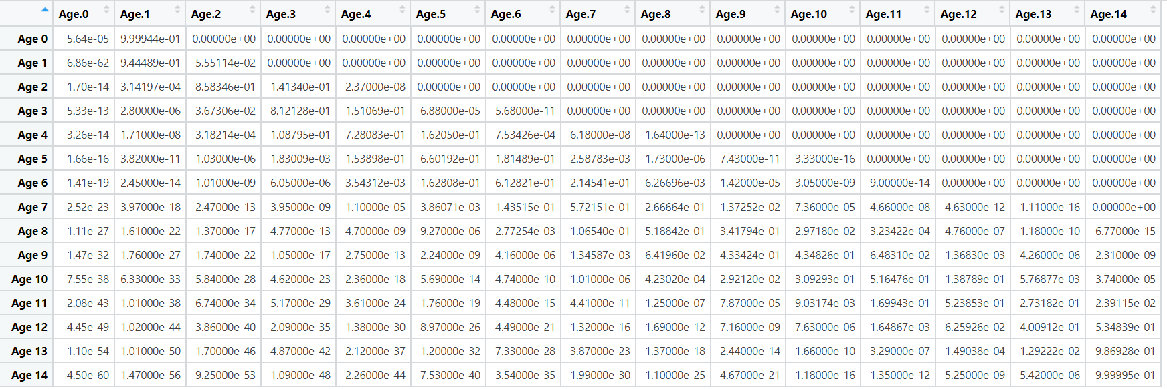
Reader index 8 – estimated ageing error matrix
Age estimate
True Age

Slide 9
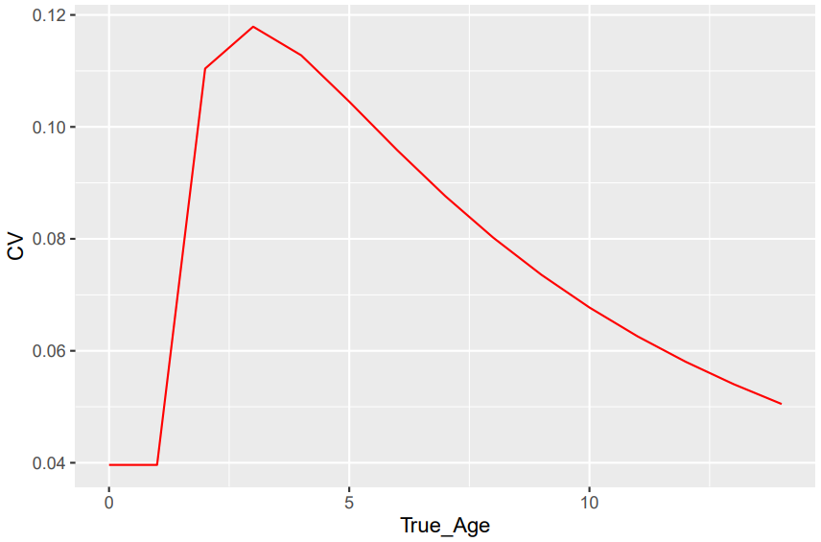
Reader index 8 – estimated CV

Slide 10

Reader index 8 – simulated data

Slide 11
Reader index 21
Best supported model showed bias
  Bias: Curvilinear, i.e., a 2-parameter Hollings-form relationship of bias with true age
  Error: Constant CV, i.e., a 1 parameter linear relationship of SD with true age.

Slide 12
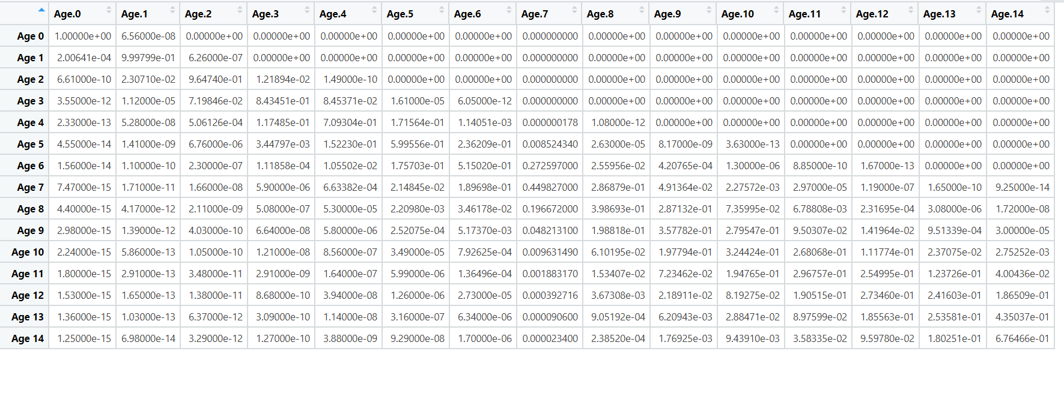
Reader index 21 – estimated ageing error matrix
Age estimate
True Age

Slide 13
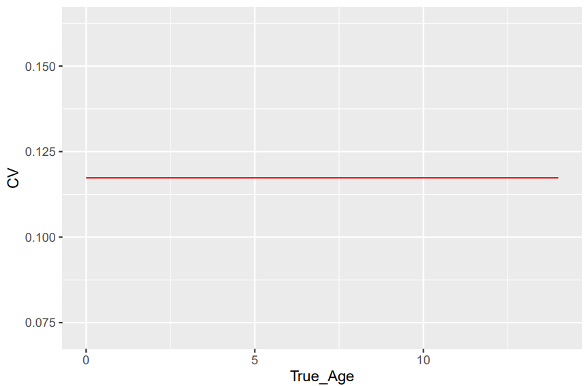
Reader index 21 – estimated CV

Slide 14
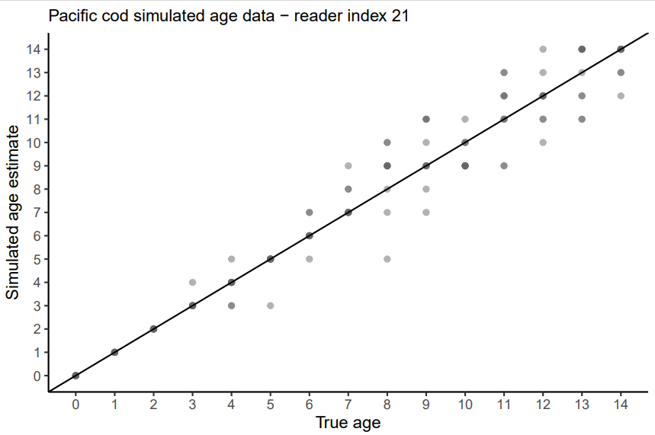
Reader index 21 – simulated data

Slide 15
Reader index 59
Best supported model showed bias B0_S1_S3
  No bias
  Error: Constant CV, i.e., a 1 parameter linear relationship of SD with true age.

Slide 16
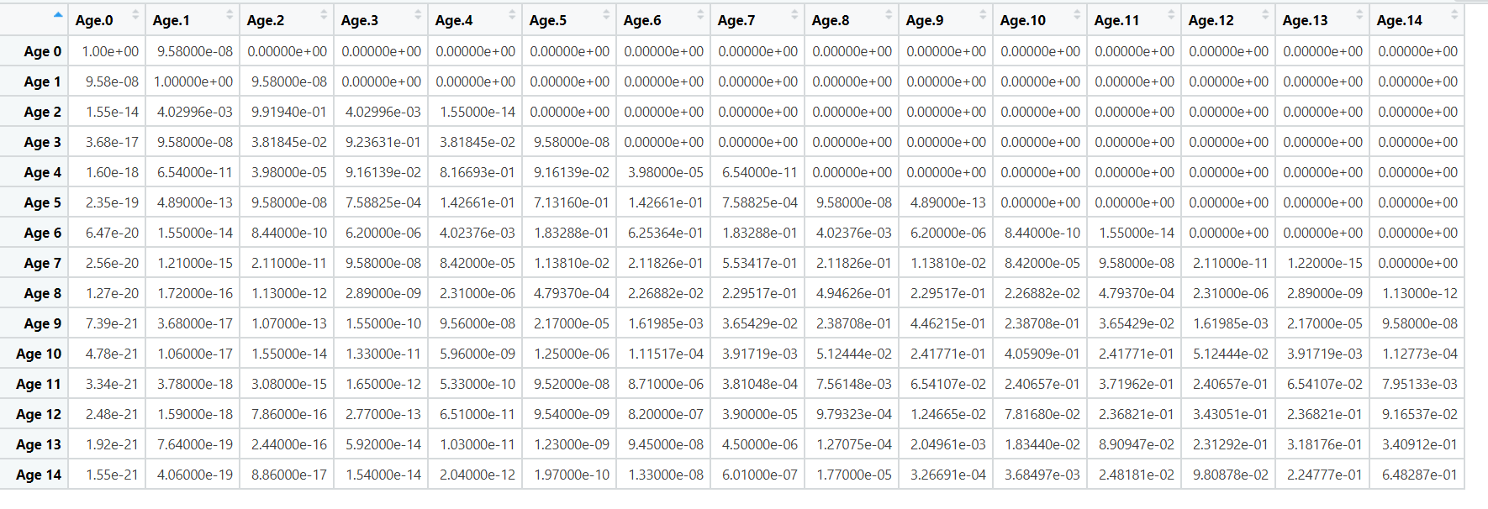
Reader index 59 – estimated ageing error matrix
Age estimate
True Age

Slide 17
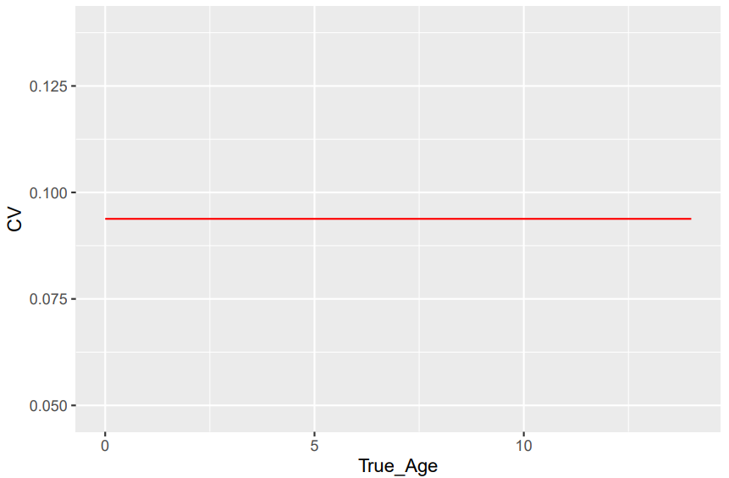
Reader index 59 – estimated CV

Slide 18

Reader index 59 – simulated data

Slide 19
Reader index 71
Best supported model showed:
  Bias: Curvilinear, i.e., a 2-parameter Hollings-form relationship of bias with true age
  Error: Constant CV, i.e., a 1 parameter linear relationship of SD with true age.

Slide 20
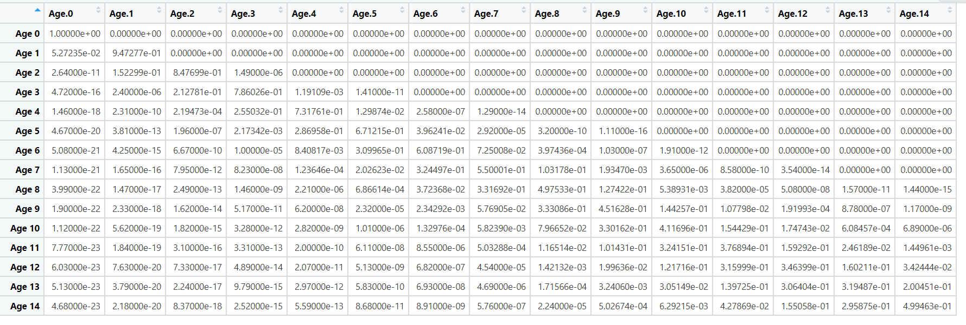
Reader index 71 – estimated ageing error matrix
Age estimate
True Age

Slide 21

Reader index 71 – estimated CV

Slide 22
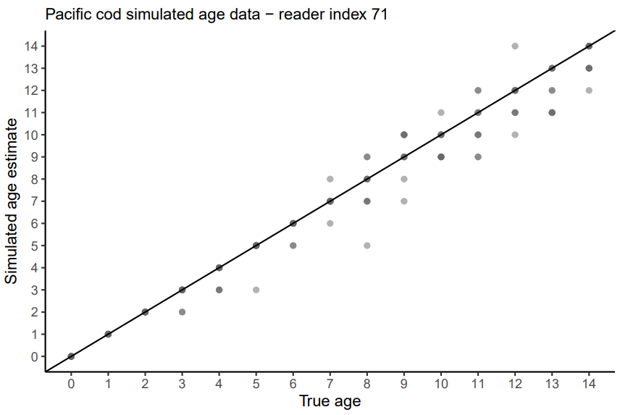
Reader index 71 – simulated data

